Slide 1

Chapter 9:
Queuing Models
© 2007 Pearson Education

Slide 2
Queuing or Waiting Line Analysis
Queues (waiting lines) affect people everyday
A primary goal is finding the best level of service
Analytical modeling (using formulas) can be used for many queues
For more complex situations, computer simulation is needed

Slide 3
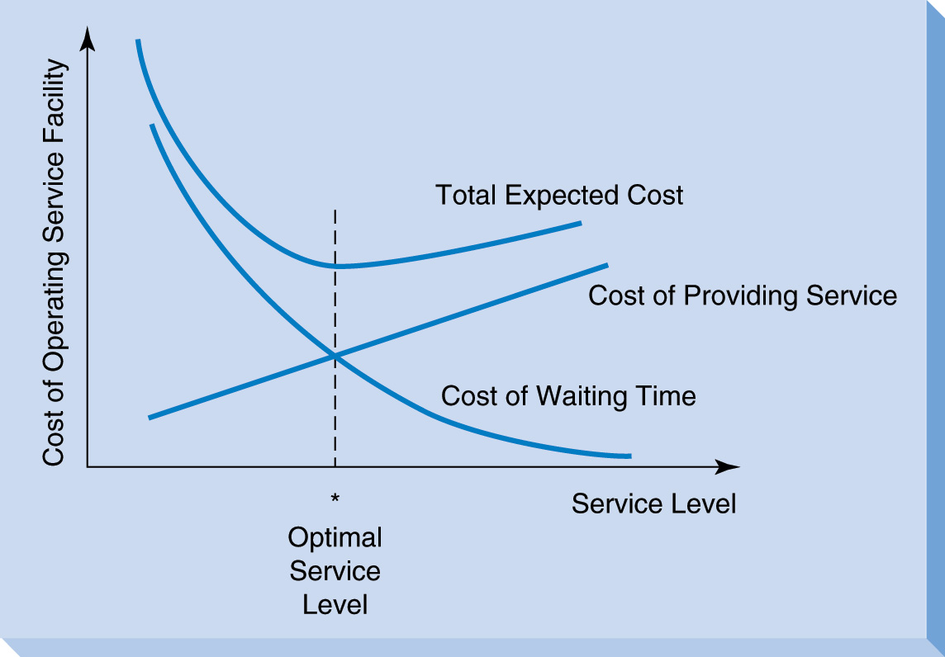
Queuing System Costs
Cost of providing service
Cost of not providing service (waiting time)

Slide 4
Three Rivers Shipping Example
Average of 5 ships arrive per 12 hr shift
A team of stevedores unloads each ship
Each team of stevedores costs $6000/shift
The cost of keeping a ship waiting is $1000/hour
How many teams of stevedores to employ to minimize system cost?

Slide 5
Three Rivers Waiting Line Cost Analysis
 | Number of Teams of Stevedores
 | 1 | 2 | 3 | 4
Ave hours waiting per ship | 7 | 4 | 3 | 2
Cost of ship waiting time (per shift) | $35,000 | $20,000 | $15,000 | $10,000
Stevedore cost (per shift) | $6000 | $12,000 | $18,000 | $24,000
Total Cost | $41,000 | $32,000 | $33,000 | $34,000

Slide 6
Characteristics of a
Queuing System
The queuing system is determined by:
Arrival characteristics
Queue characteristics
Service facility characteristics

Slide 7
Arrival Characteristics
Size of the arrival population – either infinite or limited
Arrival distribution:
  Either fixed or random
  Either measured by time between consecutive arrivals, or arrival rate
  The Poisson distribution is often used for random arrivals

Slide 8
Poisson Distribution
Average arrival rate is known
Average arrival rate is constant for some number of time periods
Number of arrivals in each time period is independent
As the time interval approaches 0, the average number of arrivals approaches 0

Slide 9
Poisson Distribution
λ = the average arrival rate per time unit
P(x) = the probability of exactly x arrivals occurring during one time period
P(x) = e^{-λ} λ^{x}
x!

Slide 10
Behavior of Arrivals
Most queuing formulas assume that all arrivals stay until service is completed
Balking refers to customers who do not join the queue
Reneging refers to customers who join the queue but give up and leave before completing service

Slide 11
Queue Characteristics
Queue length (max possible queue length) – either limited or unlimited
Service discipline – usually FIFO (First In First Out)

Slide 12
Service Facility Characteristics
Configuration of service facility
  Number of servers (or channels)
  Number of phases (or service stops)
Service distribution
  The time it takes to serve 1 arrival
  Can be fixed or random
  Exponential distribution is often used

Slide 13
Exponential Distribution
μ = average service time
t = the length of service time (t > 0)
P(t) = probability that service time will be greater than t
P(t) = e^{- μt}

Slide 14
Measuring Queue Performance
ρ = utilization factor (probability of all
servers being busy)
L_{q} = average number in the queue
L = average number in the system
W_{q} = average waiting time
W = average time in the system
P₀ = probability of 0 customers in system
P_{n} = probability of exactly n customers in system

Slide 15
Kendall’s Notation
A / B / s
A = Arrival distribution
    (M for Poisson, D for deterministic, and G for general)
B = Service time distribution
(M for exponential, D for deterministic, and G for general)
S = number of servers

Slide 16
The Queuing Models
Covered Here All Assume
Arrivals follow the Poisson distribution
FIFO service
Single phase
Unlimited queue length
Steady state conditions
We will look at 5 of the most commonly used queuing systems.

Slide 17
Models Covered
Name (Kendall Notation) | Example
Simple system (M / M / 1) | Customer service desk in a store
Multiple server (M / M / s) | Airline ticket counter
Constant service (M / D / 1) | Automated car wash
General service (M / G / 1) | Auto repair shop
Limited population (M / M / s / ∞ / N) | An operation with only 12 machines that might break

Slide 18
Single Server Queuing System (M/M/1)
Poisson arrivals
Arrival population is unlimited
Exponential service times
All arrivals wait to be served
λ is constant
μ > λ (average service rate > average arrival rate)

Slide 19
Operating Characteristics for M/M/1 Queue
Average server utilization
ρ = λ / μ
Average number of customers waiting
  L_{q} = λ²
  μ(μ – λ)
Average number in system
L = L_{q} + λ / μ

Slide 20
Average waiting time
W_{q} = L_{q} = λ
λ μ(μ – λ)
Average time in the system
  W = W_{q} + 1/ μ
Probability of 0 customers in system
P₀ = 1 – λ/μ
Probability of exactly n customers in system
P_{n} = (λ/μ )^{n} P₀

Slide 21
Arnold’s Muffler Shop Example
Customers arrive on average 2 per hour
(λ = 2 per hour)
Average service time is 20 minutes
(μ = 3 per hour)
Install ExcelModules
Go to file 9-2.xls

Slide 22
Total Cost of Queuing System
Total Cost = C_{w} x L + C_{s} x s
C_{w} = cost of customer waiting time per time period
L = average number customers in system
C_{s} = cost of servers per time period
s = number of servers

Slide 23
Multiple Server System (M / M / s)
Poisson arrivals
Exponential service times
s servers
Total service rate must exceed arrival rate
( sμ > λ)
Many of the operating characteristic formulas are more complicated

Slide 24
Arnold’s Muffler Shop
With Multiple Servers
Two options have already been considered:
System
Cost
Keep the current system (s=1) $32/hr
Get a faster mechanic (s=1) $25/hr
Multi-server option
Have 2 mechanics (s=2) ?
Go to file 9-3.xls

Slide 25
Single Server System With Constant Service Time (M/D/1)
Poisson arrivals
Constant service times (not random)
Has shorter queues than M/M/1 system
  - Lq and Wq are one-half as large

Slide 26
Garcia-Golding Recycling Example
λ = 8 trucks per hour (random)
μ = 12 trucks per hour (fixed)
Truck & driver waiting cost is $60/hour
New compactor will be amortized at $3/unload
Total cost per unload = ?
Go to file 9-4.xls

Slide 27
Single Server System With
General Service Time (M/G/1)
Poisson arrivals
General service time distribution with known mean (μ) and standard deviation (σ)
μ > λ

Slide 28
Professor Crino Office Hours
Students arrive randomly at an average rate of, λ = 5 per hour
Service (advising) time is random at an average rate of, μ = 6 per hour
The service time standard deviation is,
σ = 0.0833 hours
Go to file 9-5.xls

Slide 29
Muti-Server System With
Finite Population (M/M/s/∞/N)
Poisson arrivals
Exponential service times
s servers with identical service time distributions
Limited population of size N
Arrival rate decreases as queue lengthens

Slide 30
Department of Commerce Example
Uses 5 printers (N=5)
Printers breakdown on average every 20 hours
  λ = 1 printer = 0.05 printers per hour
  20 hours
Average service time is 2 hours
  μ = 1 printer = 0.5 printers per hour
  2 hours
  Go to file 9-6.xls

Slide 31
More Complex Queuing Systems
When a queuing system is more complex, formulas may not be available
The only option may be to use computer simulation, which we will study in the next chapter

